Slide 1
Overview of Contingency Planning and Preparedness
CGPRT(W) : Ensuring Clean Seas and Coasts in Western Region ……

Slide 2
Objective
To introduce you to the OPRC Convention and the main elements of the Convention
To consider the differing levels of contingency plans required for oil spill preparedness
To consider a tiered approach to oil spill planning, preparedness and response
To consider the general planning requirements at the Strategic Level
To consider how to use plans effectively
CGPRT(W) : Ensuring Clean Seas and Coasts in Western Region ……

Slide 3
OPRC Convention
  Global framework for international cooperation in combating major oil pollution incidents or the threat of major oil pollution
  Parties to establish measures to deal with pollution incidents either nationally or in cooperation with other countries
CGPRT(W) : Ensuring Clean Seas and Coasts in Western Region ……

Slide 4
OPRC Convention
  Entered into force on 13 May 1995
  109 Contracting States, as of January 2016 (www.imo.org).
  Oil is defined as petroleum in any form including crude oil, fuel oil, sludge, oil refuse and refined products
  A Protocol to the OPRC relating to hazardous and noxious substances (OPRC-HNS Protocol) was adopted in 2000
CGPRT(W) : Ensuring Clean Seas and Coasts in Western Region ……

Slide 5
OPRC Convention
The OPRC Convention applies to:
  Member States that have ratified, accepted or acceded to the Convention (Contracting States)
  Ships flying the flag of a Contracting State
  Operators of offshore units of a Contracting State
  Sea ports and oil handling facilities (including oil terminals and pipelines) of a Contracting State
CGPRT(W) : Ensuring Clean Seas and Coasts in Western Region ……

Slide 6
OPRC Convention
    Key measures are to include:
      Oil pollution emergency plans (Article 3)
      Reporting procedures and actions (Articles 4 and 5)
      National and Regional systems for preparedness and response (Article 6)
      International cooperation (Article 7)
      Promotion of bilateral and multilateral cooperation in preparedness and response (Article 10)
CGPRT(W) : Ensuring Clean Seas and Coasts in Western Region ……

Slide 7
OPRC Convention
In particular Article 6 (National and Regional systems for preparedness and response) calls for:
  A designated competent national authority
  A national contingency plan within the national capabilities, either individually or through bilateral/multilateral cooperation and, as appropriate, in cooperation with the oil and shipping industries, port authorities and other relevant entities:
  Minimum level of pre-positioned equipment, commensurate with risk
  Programme of exercises and training
  Detailed plans and communication capabilities
  Arrangements to coordinate the response
CGPRT(W) : Ensuring Clean Seas and Coasts in Western Region ……

Slide 8
Exercises
OPRC Article 6(2) also requires each party to establish:
a programme of exercises for oil pollution response organizations and training of relevant personnel
This should include the exercising of all components of your contingency plans.
CGPRT(W) : Ensuring Clean Seas and Coasts in Western Region ……

Slide 9
Exercises
Purpose to test
  The plan
  The equipment
  The capabilities of the response team and the resources available to them
Guiding Principles
  Ensure support for the activity at all levels of management
  Set clear, realistic and measurable objectives
  Evaluating the exercise effectively is as important as conducting it effectively
CGPRT(W) : Ensuring Clean Seas and Coasts in Western Region ……

Slide 10
Exercises
These exercises can include:
Notification exercise
  test the procedures to alert and call out the response teams via telephone or other means
Table-top exercise
  interactively discuss a simulated scenario among members of a response team without involving the mobilization of personnel and equipment
Equipment deployment exercise
  exercise deployment of oil spill response equipment at particular locations in response to an oil spill scenario
Incident management exercise
  simulate several different aspects of an oil spill incident with third parties who would actually be involved in a real emergency to test and train a whole response team
CGPRT(W) : Ensuring Clean Seas and Coasts in Western Region ……

Slide 11
Training
OPRC Article 6(2) also requires each party to establish:
a programme of exercises for oil pollution response organizations and training of relevant personnel
This should include theoretical training at the appropriate level and include practical equipment deployment, as required.
IMO OPRC Model Training Courses could be used as a guidance to plan and conduct a training.
CGPRT(W) : Ensuring Clean Seas and Coasts in Western Region ……

Slide 12
Why have a Contingency Plan?
To provide the policy and response framework for the organization(s)
To develop preparedness and planning for a complex response in a calm, non-emergency environment free from pressures
To fulfil the requirements of:
    international agreements, e.g. OPRC
    national laws
    company policy
CGPRT(W) : Ensuring Clean Seas and Coasts in Western Region ……

Slide 13
Plan Hierarchy - Example
Region A
Region B
CGPRT(W) : Ensuring Clean Seas and Coasts in Western Region ……

Slide 14
Tiered Approach
Tier One
  Resources necessary to handle a local spill and/or provide an initial response
  Generally a minor “operational” spill
    Hose burst, tank overflow, leaking flange
  Contained locally
  Local response with resources immediately available on site
  Local facility or SOPEP activated
CGPRT(W) : Ensuring Clean Seas and Coasts in Western Region ……

Slide 15
Tiered Approach
Tier Two
  National or regional resources necessary to supplement a Tier One response
  Generally a medium-sized spill or a spill that is not contained locally
    Collision, grounding, sub-sea leak
  Requiring additional resources from outside those immediately available on site
  Company and Area Contingency Plans activated
CGPRT(W) : Ensuring Clean Seas and Coasts in Western Region ……

Slide 16
Tiered Approach
Tier Three
  Global resources necessary for spills that require a substantial additional response
  Generally a significant spill with national consequences or regional consequences
    Grounding or Loss of vessel, blow-out, major sub-sea leak
  Not contained locally, possible cross-boundary movement
  National, Bilateral or Regional Plans activated
CGPRT(W) : Ensuring Clean Seas and Coasts in Western Region ……

Slide 17
Recommended Steps in Plan Development
7. Update plan
6. Conduct training and exercise
5. Procure appropriate equipment
4. Decide structure and layout
3. Develop a strategy
2. Conduct the risk assessments
1. Define scope of the plan
CGPRT(W) : Ensuring Clean Seas and Coasts in Western Region ……

Slide 18
Planning Considerations
General response planning considerations:
  Designation of authority responsible for development and operation of plan
  Response Hierarchy
    Tiered response
    Cooperation with industry
    Governmental arrangements
  Identification of areas of high spill risk
  Fate of oil
  Probable oil movement based on local wind and current
CGPRT(W) : Ensuring Clean Seas and Coasts in Western Region ……

Slide 19
Planning Considerations
General response planning considerations (continued):
  Coastal sensitivity mapping
  Priorities for protection
  Different response options
  Oil spill response policy
  Organization for response (IMS)
Note that different levels of plans can focus on the strategic, tactical or operational aspects of the response.
CGPRT(W) : Ensuring Clean Seas and Coasts in Western Region ……

Slide 20
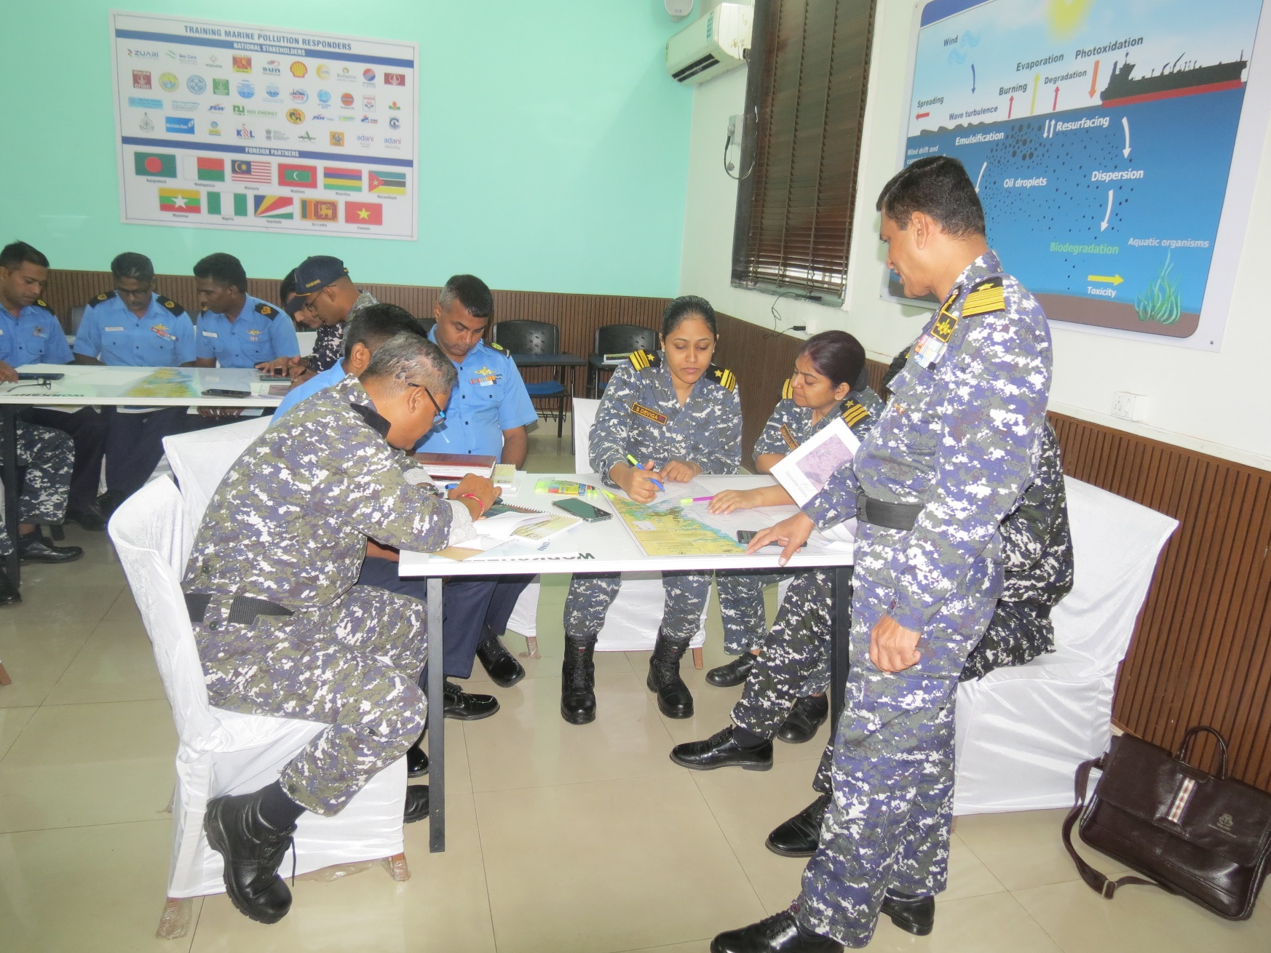
Development Process
CGPRT(W) : Ensuring Clean Seas and Coasts in Western Region ……

Slide 21
Any questions?
CGPRT(W) : Ensuring Clean Seas and Coasts in Western Region ……

